Slide 1
Life Expectancy Factors
Group 4
Ryan Egbert, Zainab Aljaroudi,
Amanda Hsu, Jackson Bronkema

Slide 2
Content
1
Main Idea
2
Data Issues
3
General Trend
4
Life Expectancy vs Other Factors
5
Correlation Matrix

Slide 3
Questions
What actions could a government take to increase their country’s average life expectancy?
What are some of the general trends in our data set?
Which factors are most closely related to Life Expectancy?

Slide 4
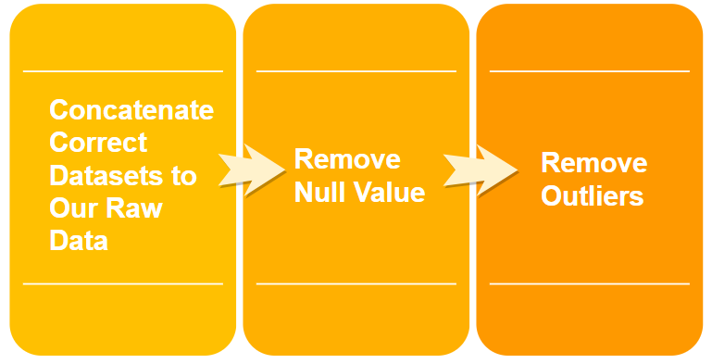
Issues with our Dataset
Problems we found : Wrong data value, Null data, and Outliers

Slide 5
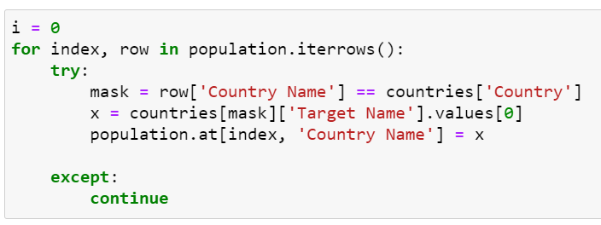
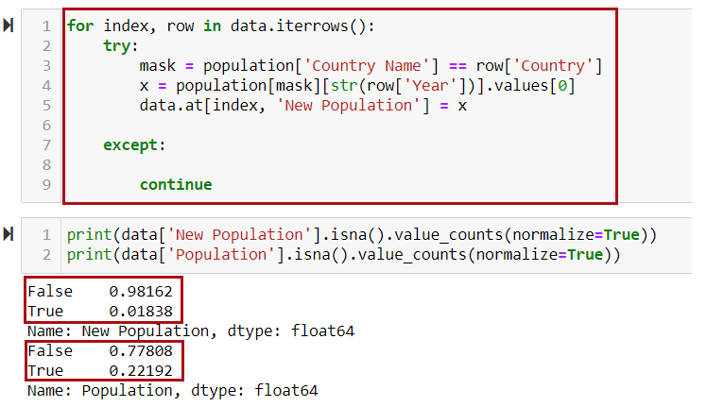
Wrong data value
Datasets which is probably wrong:
GDP
Population
Measles Immunization
BMI

Slide 6
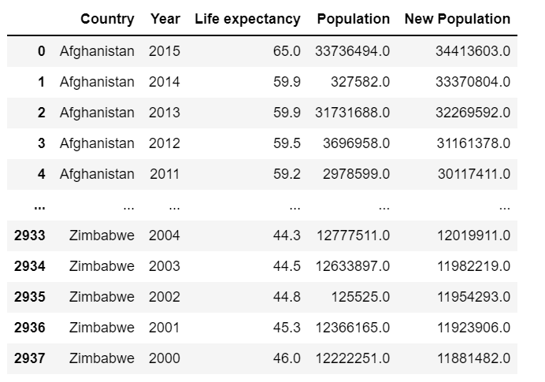
New data value

Slide 7
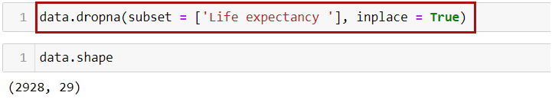
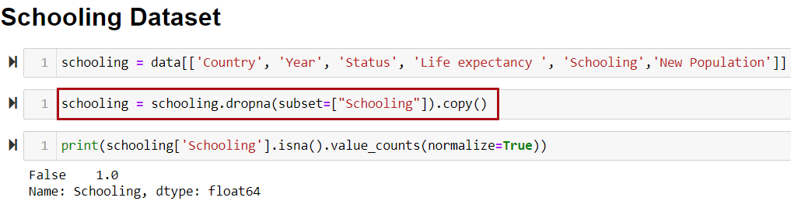
Remove Null Values
Removed all rows where Life Expectancy is Null
Created a new dataframe for each factor and removed the Null rows for that column

Slide 8
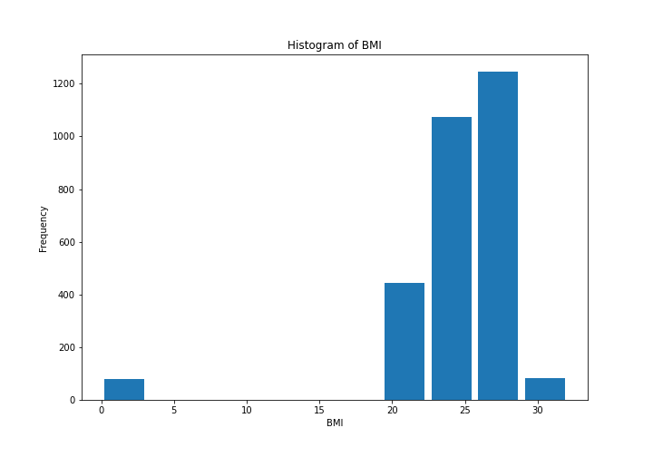
Removing Outliers

Slide 9
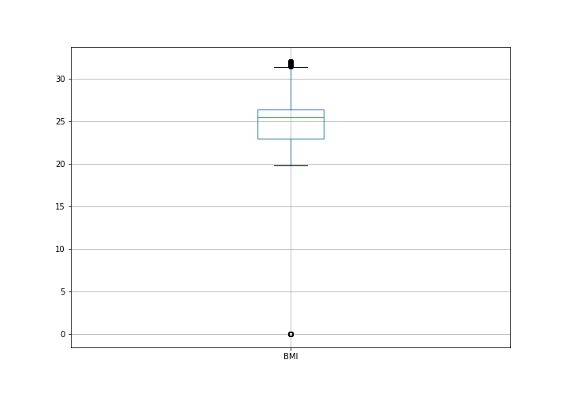
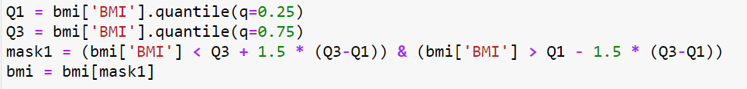
Removing Outliers

Slide 10
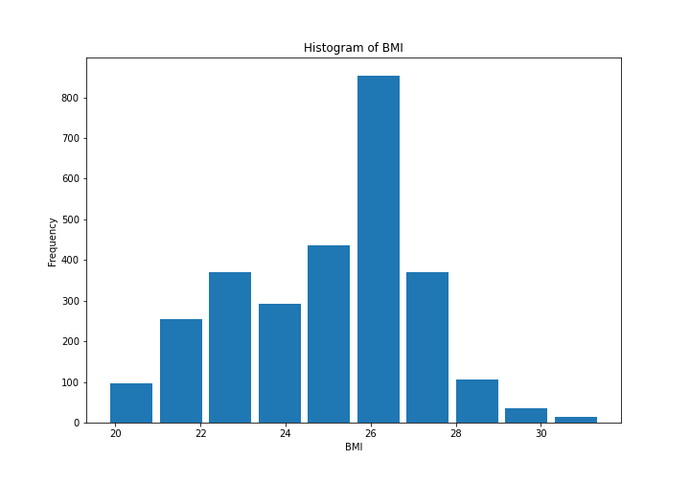
Removing Outliers

Slide 11
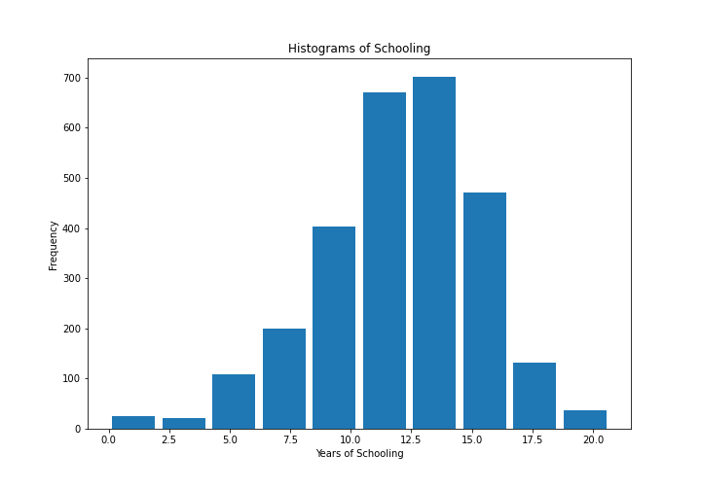
Removing Outliers

Slide 12
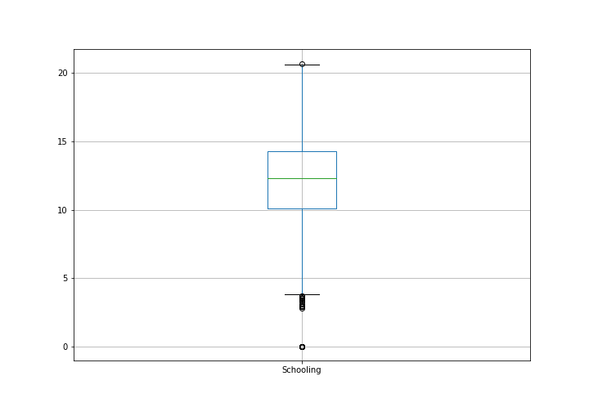
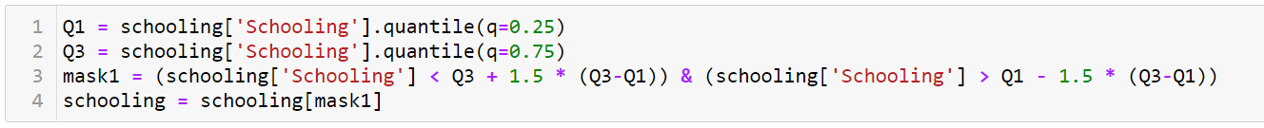
Removing Outliers

Slide 13
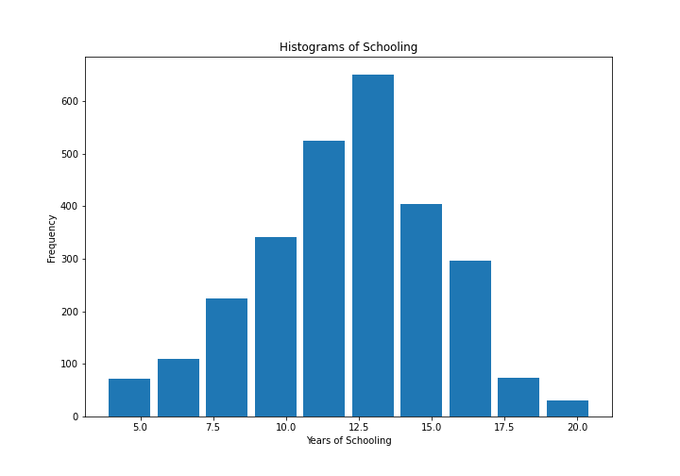
Removing Outliers

Slide 14
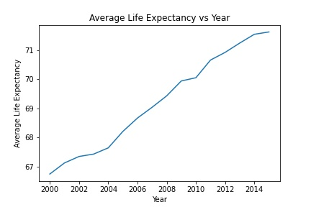
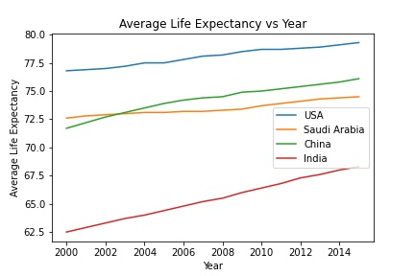
Life Expectancy Trends

Slide 15
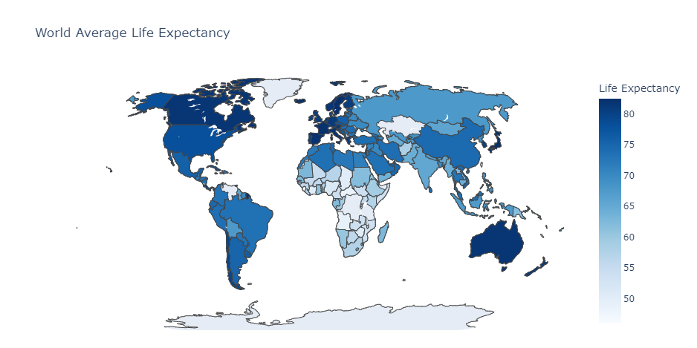
Life Expectancy Trends
Notes:
Awesomeeeeeeeeee

Slide 16
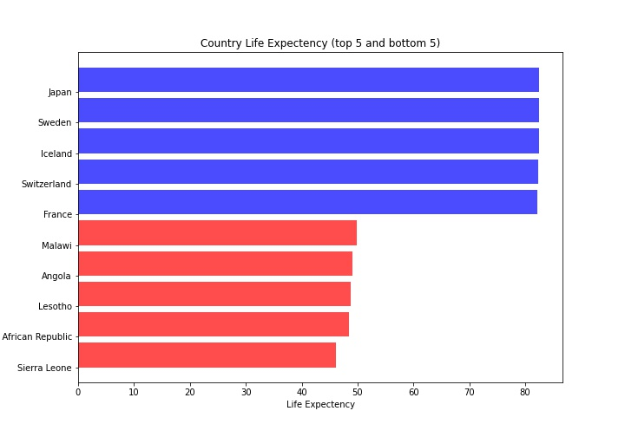
Life Expectancy Trends

Slide 17
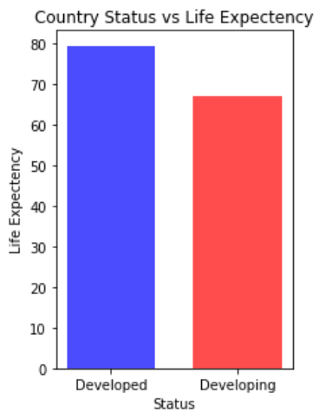
Life Expectancy Trends (Developed vs Developing)

Slide 18
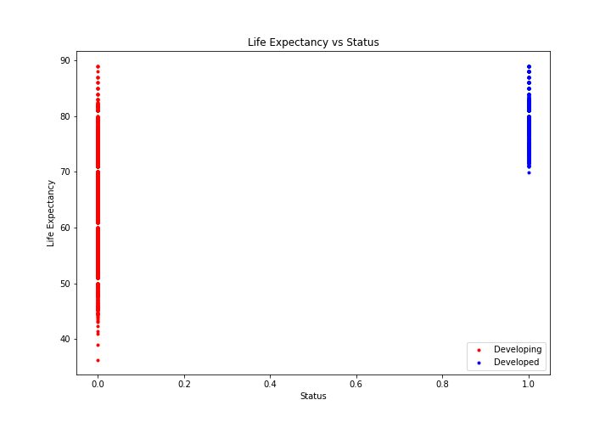
Country Status
Notes:
1 = Developed
2 = Developing

Slide 19
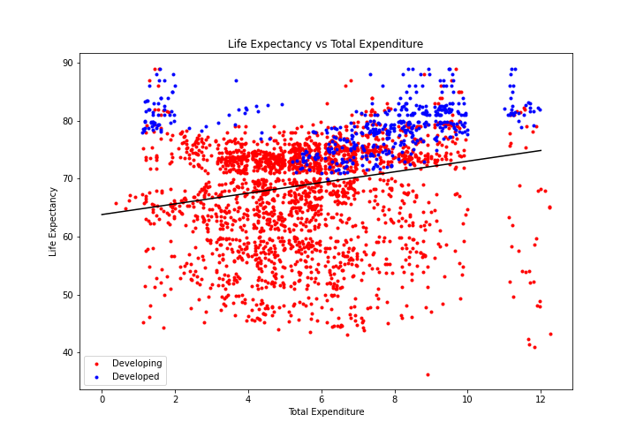
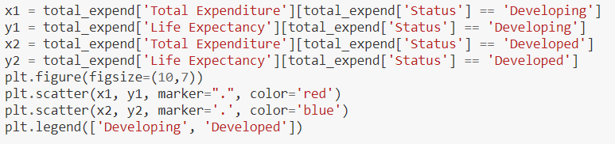
Total Expenditure
Notes:
*Economic Factors
Total Expenditure: general government expenditure on health as a percentage of the total government expenditure

Slide 20
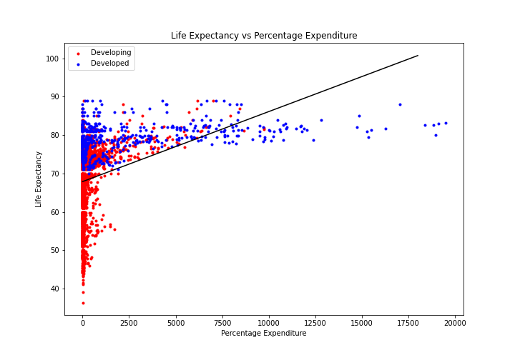
Percentage Expenditure
Notes:
Percent Expenditure: Expenditure on health as a percentage of GDP/capita
= expenditure on health / GDP

Slide 21
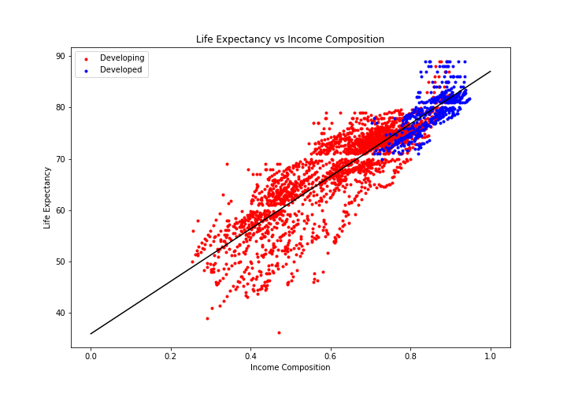
Income Composition
Notes:
Income Composition or resources. The economic component of the HDI or Human Development Index ??

Slide 22
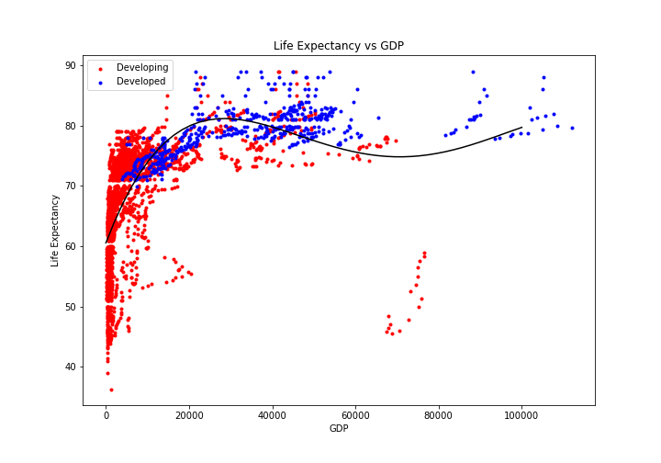
GDP per Capita
Notes:
GDP Per Capita

Slide 23
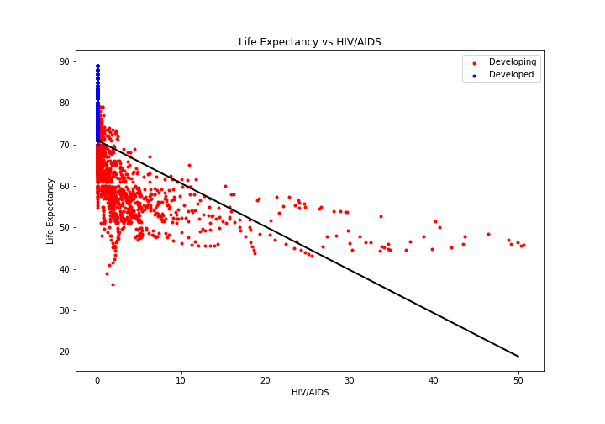
HIV/AIDS
Notes:
Deaths per 1000 births from HIV/AIDS

Slide 24
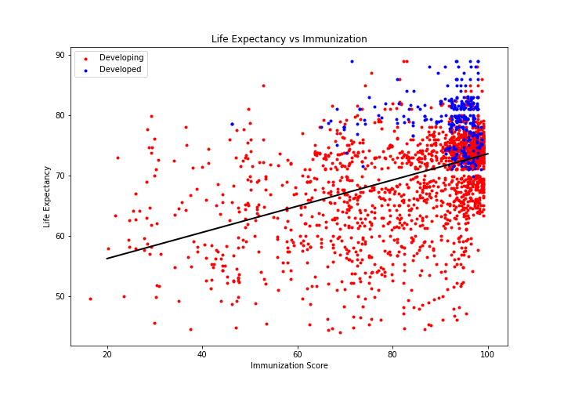
Immunization (Overall)
Immunization Score
= avg(Hepatitis B, Measles,
Polio, Diphtheria)
Notes:
A metric that we created taking the average of Hep B, Measles, Polio, and Diphtheria as a composite score for each country. Each of these represents the percentage of adults who have received each vaccination

Slide 25
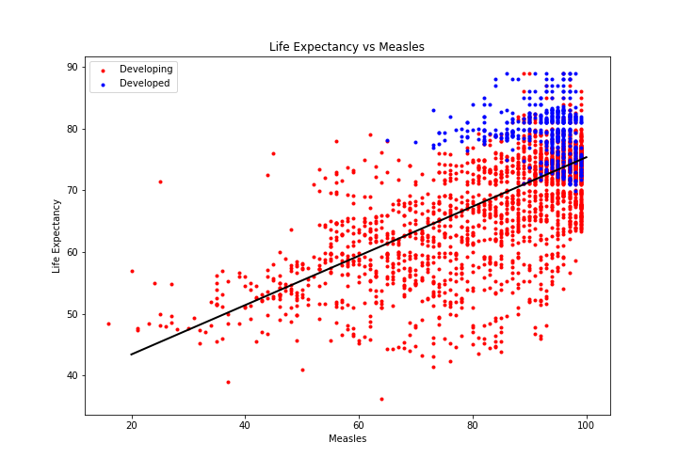
Measles
Notes:
Percentage of adults who have received the Measles immunization coverage (MMR)

Slide 26
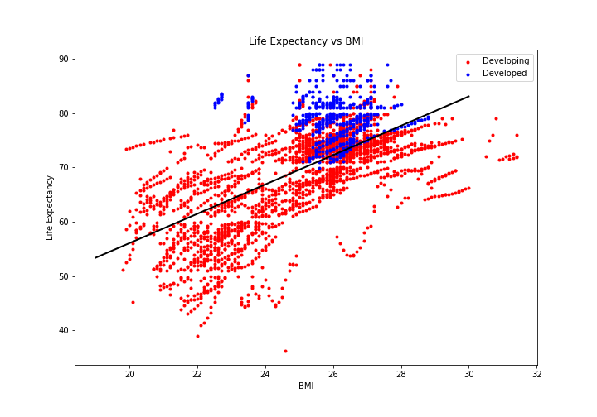
BMI
Notes:
*Social Factors
Life expectancy vs average Body Mass Index

Slide 27
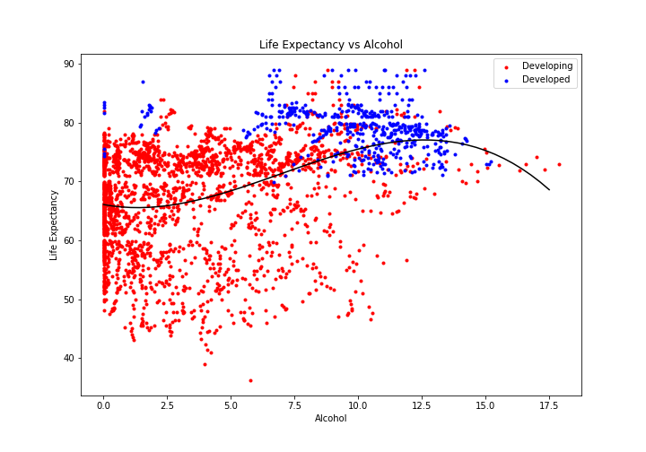
Alcohol
Notes:
Alcohol: average number of litres of pure alcholoh by the citizens of a country that are 15 or older

Slide 28
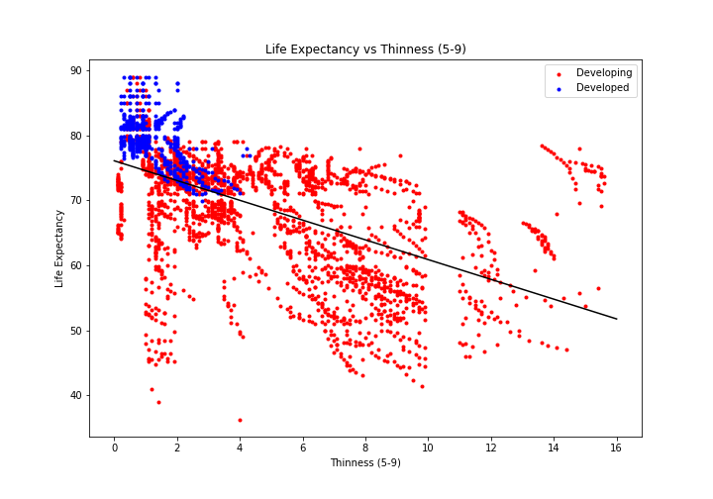
Thinness (5-9)
Notes:
Prevalence of Thinness as a percentage among children and young adults from age 5-9
** A higher percentage here using means that there is a high level of malnourishment in that country
Hence a negative correlation
** Thinness defined as when a person has a BMI < 17

Slide 29
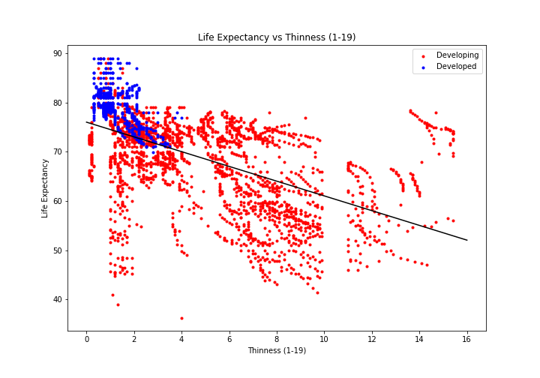
Thinness: Ages 1-19
Notes:
Prevalence of Thinness as a percentage among children and young adults from age 1-19
** A higher percentage here using means that there is a high level of malnourishment in that country
Hence a negative correlation
** Thinness defined as when a person has a BMI < 17

Slide 30
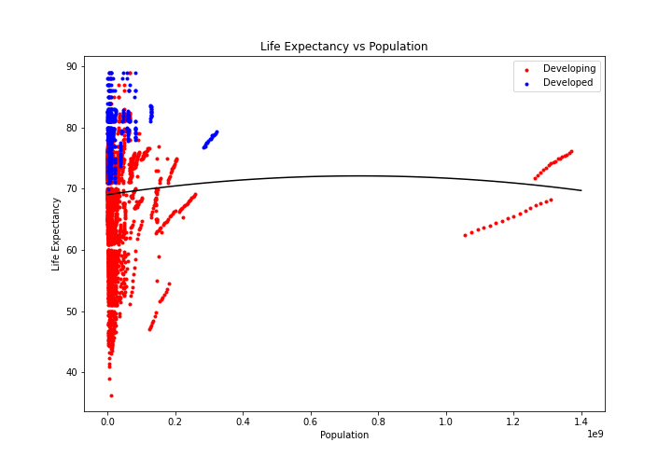
Population
Notes:
*Social Factor
Life Expectancy vs total population

Slide 31
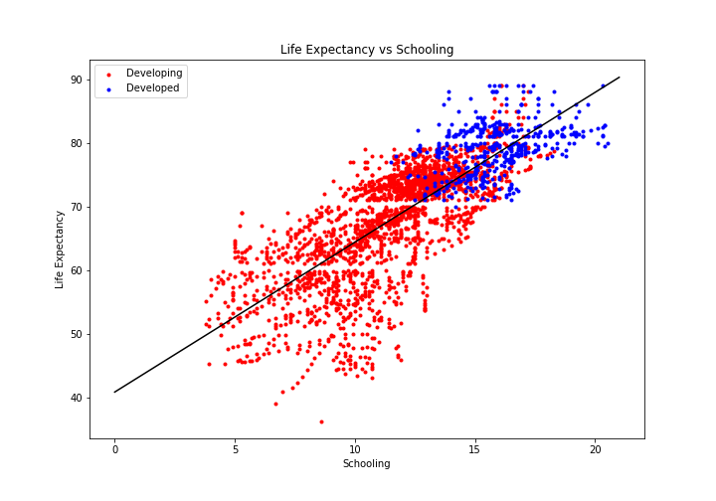
Average Years of Schooling
Notes:
Schooling: average number of years of schooling for each citizen

Slide 32
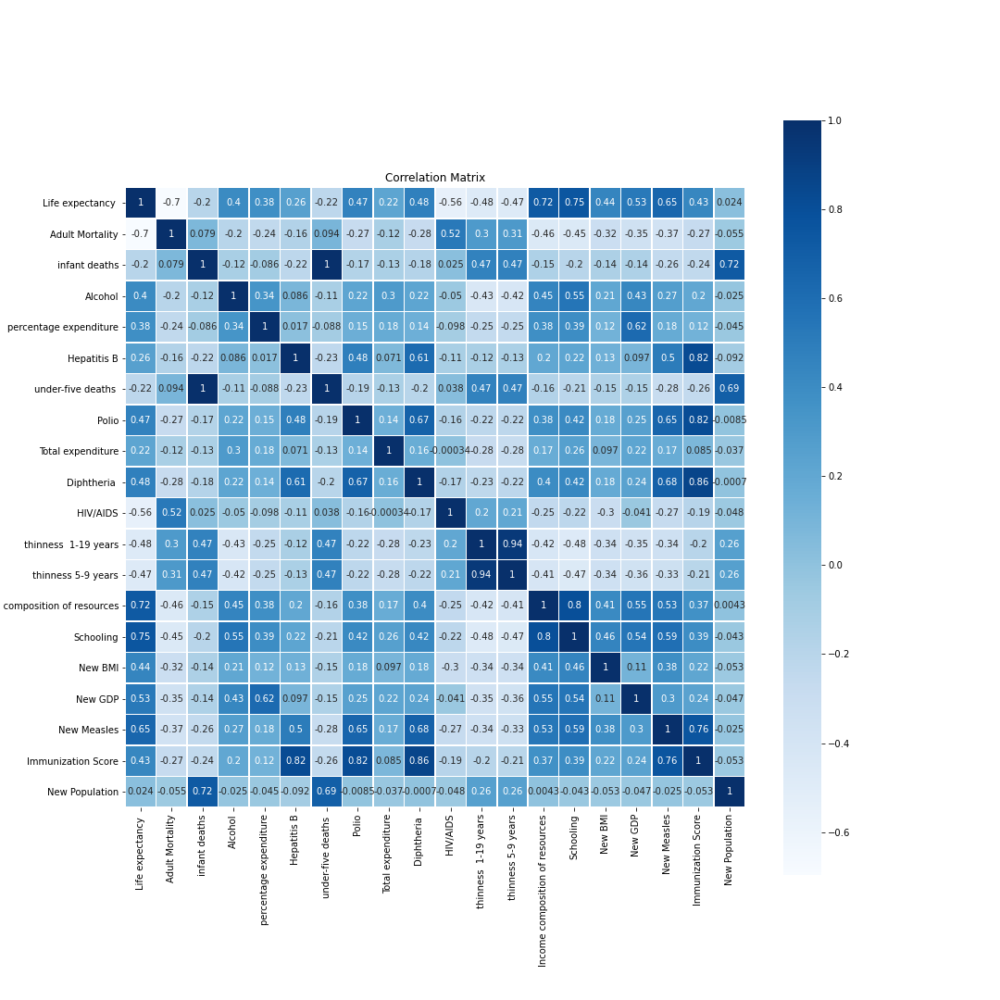
Correlation Matrix for All Factors
Notes:
*should we put adult mortality on the list?

Slide 33
Correlation Matrix for All Factors
Highest Correlated Factors:
1- Schooling
2- Income Composition of Resources
3- Measles
4- HIV/AIDS
5- GDP
Notes:
*should we put adult mortality on the list?
“The Human Development Index (HDI) is a statistic composite index of life expectancy, education, and per capita income
indicators, which are used to rank countries into four tiers of human development. A country scores a higher HDI when the lifespan is higher, the education level is higher, and the gross national income GNI (PPP) per capita is higher.”
This feature is an index that includes multiple other features. It has information about life expectancy

Slide 34
What Actions Should a Country take to Improve Life Expectancy?
Focus on the importance of education
Take actions to increase income composition of resources
Encourage their citizens to get the measles vaccination (MMR)
Educate their citizens on HIV/AIDS Prevention
Notes:
Although the income composition of resources includes ‘life expectancy, it is still possible that the other features provide a positive influence.
Therefore, besides saying increase income composition resources, we could also mention that country should focus on other features (like GNI index and education index)

